Slide 1
4
6
0
2
0
1
1
5
4
7
3
3
2
data # | Dot | Line | hist | …
0 | Update 0 | Update 0
1 | Update 1 | Update 1, 2
2 | Update 2 | Update 3
3 | Update 3 | Update 4
4 | Update 4 | Update 0
5 | Update 5 | Update 1
6 | Update 6 | Update 2
7 | Update 7 | Update 3, 4

Slide 2
4
6
0
2
0
1
1
5
4
7
3
3
2
Dot | Line | hist | …
Update func | Update func

Slide 3
Web browser
Data generation
(data.js)
R

Slide 4
mainArr
drawing line
calc
axis
axis
axis
axis
line

Slide 5
D
 | 0 | 1 | 2 | 3 | 4
0 | 1
1
2
3
4
5
6
7
L
3
0
0
1
5
1
2
7
4
3
4
6

Slide 6
3
L
 | 0 | 1 | 2 | 3 | 4
0 | 1 | 0 | 0 | 0 | 0
1 | 0 | 1 | 1 | 0 | 0
2 | 0 | 0 | 0 | 0 | 0
3 | 1 | 1 | 0 | 0 | 0
4 | 0 | 0 | 0 | 1 | 0
5 | 0 | 0 | 1 | 0 | 1
6 | 0 | 0 | 0 | 0 | 1
7 | 0 | 0 | 0 | 1 | 0
D
0
5
1
7
4
6
0
1
2
4
3

Slide 7
 | 0 | 1 | 2 | 3 | 4
0 | 1 | 0 | 0 | 0 | 0
1 | 0 | 1 | 1 | 0 | 0
2 | 0 | 0 | 0 | 0 | 0
3 | 1 | 1 | 0 | 0 | 0
4 | 0 | 0 | 0 | 1 | 0
5 | 0 | 0 | 1 | 0 | 1
6 | 0 | 0 | 0 | 0 | 1
7 | 0 | 0 | 0 | 1 | 0
Dot update
Line update
1 | 0 | 0 | 0 | 0 | 1 | 0 | 1
1 | 0 | 1 | 1 | 1
(1: selected, 0: unselected)
<Relationship Array>

Slide 8
Dot update
Histogram Update
p nodes
 | 0 | 1 | 2 | … | n-1
0 | 1 | 0 | 0 | … | 0
1 | 0 | 1 | 1 | … | 0
2 | 0 | 0 | 0 | … | 0
3 | 1 | 1 | 0 | … | 0
4 | 0 | 0 | 0 | … | 0
︙ | ︙ | ︙ | ︙ | ︙ | ︙
p-1 | 0 | 0 | 0 | … | 0
n nodes
1 | 0 | 0 | 0 | 0 | 〮〮〮 | 1
1 | 0 | 1 | 〮〮〮 | 1
isSelected for dot graph
isSelected for histogram graph
<Relationship Array>

Slide 9
Theoph
dot
Axis1
R
histObj1
loffObj1
line
Axis2
bar
: Data Object
: Graph Object
: Axis Object

Slide 10
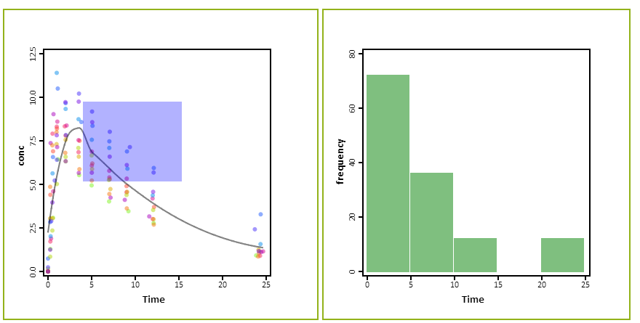
drag select!

Slide 11
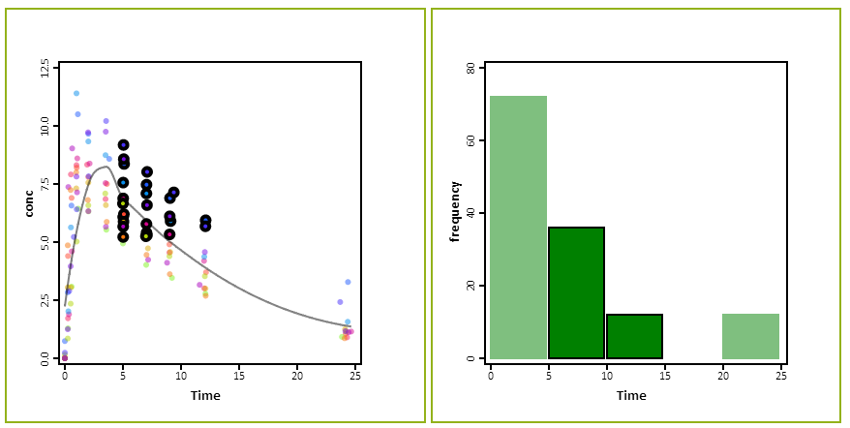

Slide 12
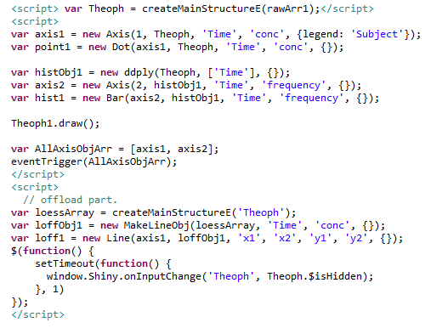

Slide 13
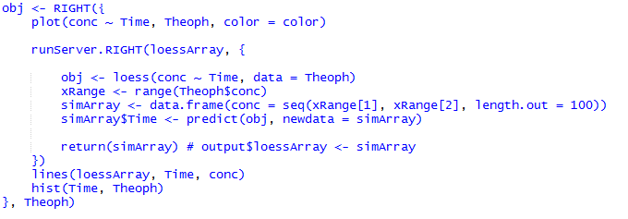

Slide 14


Slide 15
 | 0 | 1 | 2 | … | p-1
0 | 1 | 0 | 0 | … | 0
1 | 0 | 1 | 1 | … | 0
2 | 0 | 0 | 0 | … | 0
3 | 1 | 1 | 0 | … | 0
4 | 0 | 0 | 0 | … | 0
5 | 0 | 0 | 1 | … | 1
︙ | ︙ | ︙ | ︙ |  | ︙
n-1 | 0 | 0 | 0 | … | 0

